Slide 1
Spring Security

Slide 2
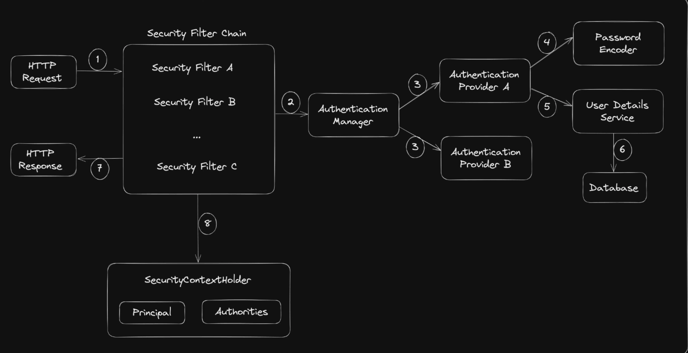

Slide 3
